Slide 1
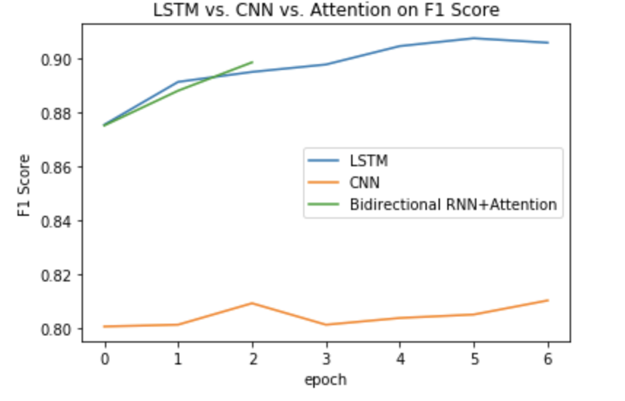
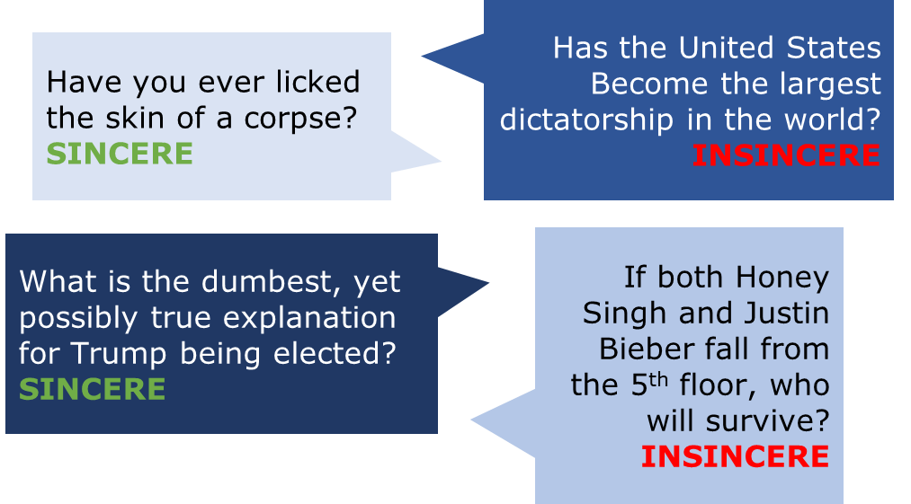
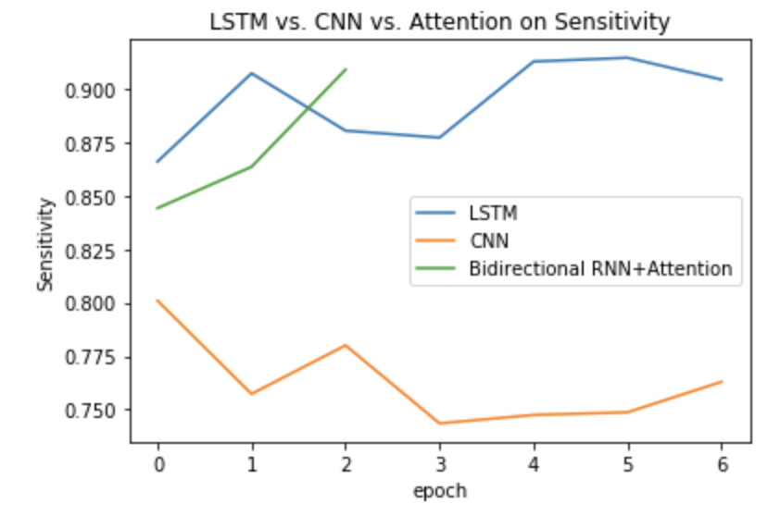

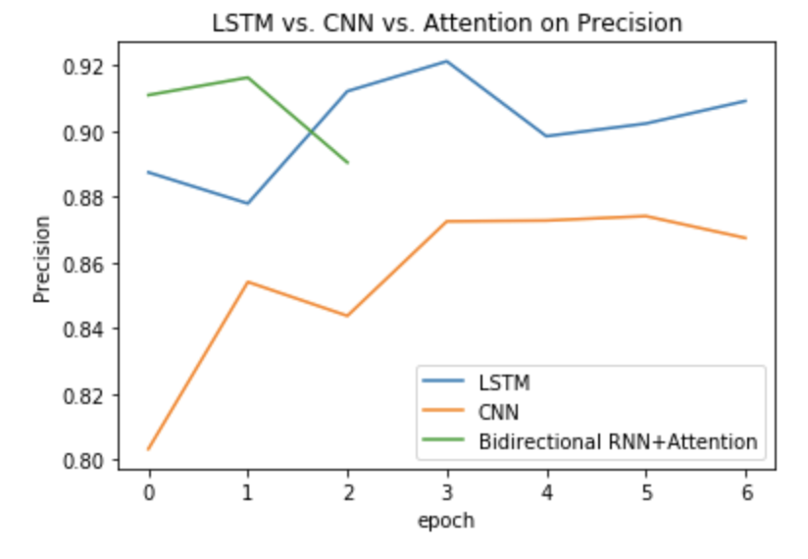
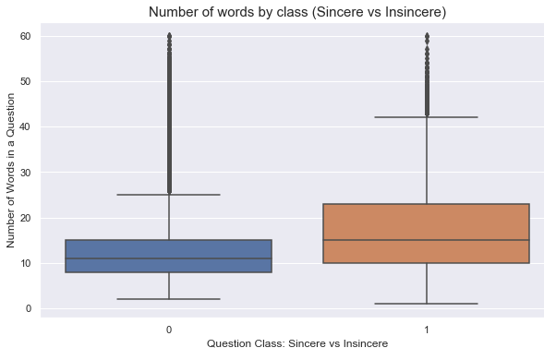
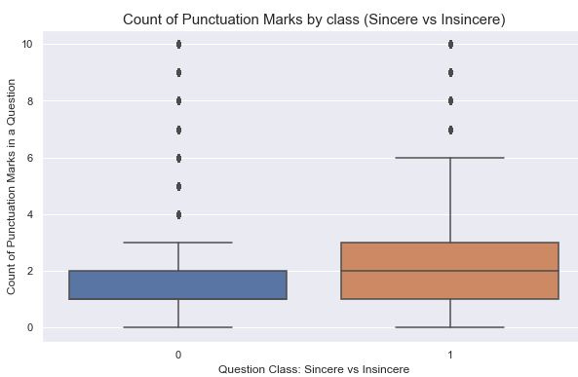
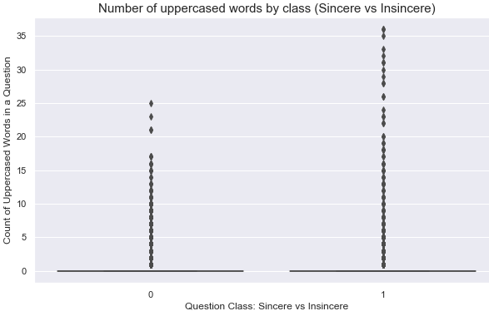

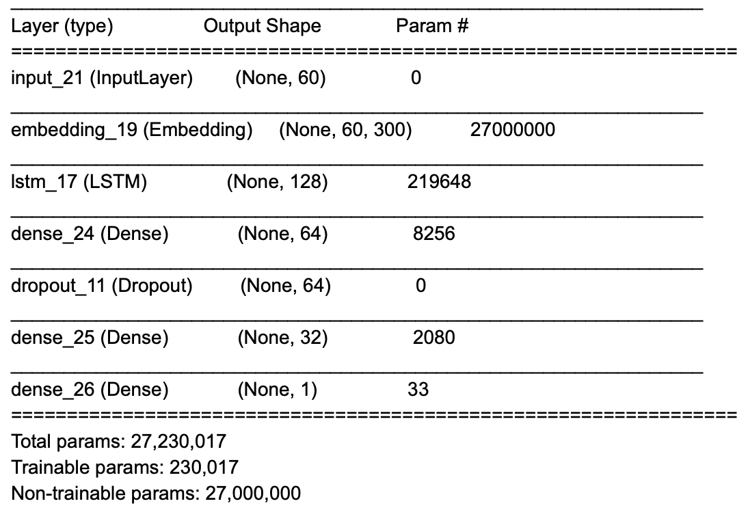
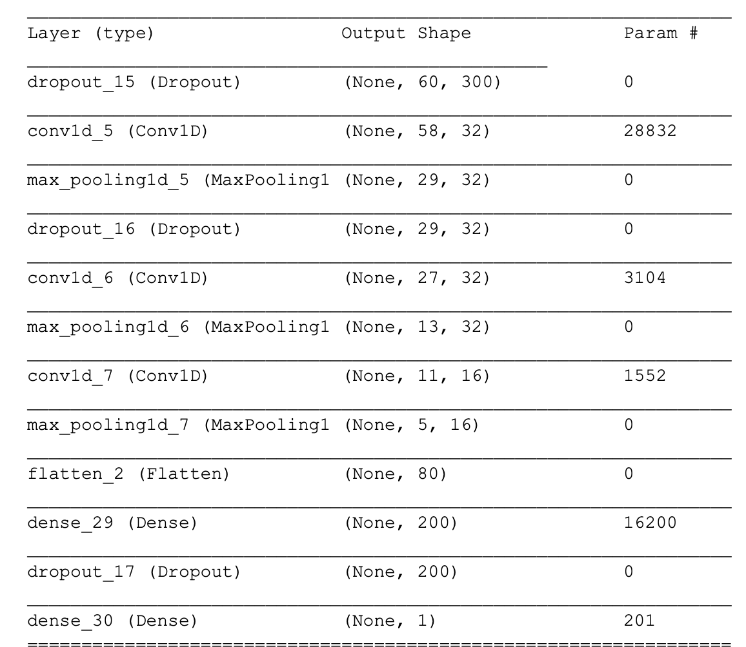
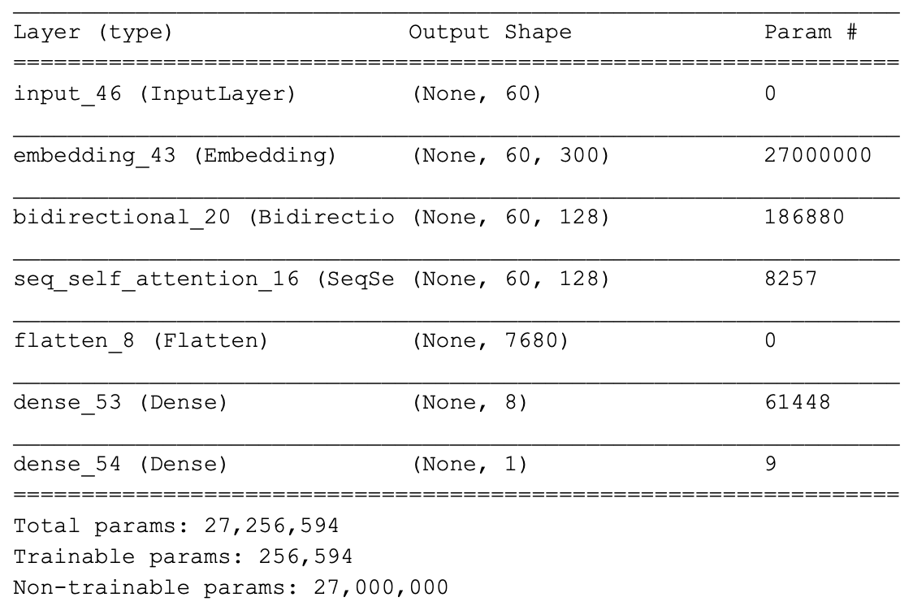

Detection of Question Sincerity on Online Forums Kate Bosshart & Siyao Peng, Georgetown University
ABSTRACT
DESCRIPTION OF DATA
ANALYSIS OF RESULTS
Research was performed to determine whether sincerity of questions posted on online question and answer (Q&A) forums could be systematically and accurately identified. Utilizing a training set of labeled questions sourced from Quora, the data was augmented and cleaned. From there, three neural networks were developed and trained, and then tested on a held-out portion of the dataset. Ultimately, it was determined that an Attention Model was able to successfully flag insincere questions in the training data.
DATA EXPLORATION Training data pulled from Kaggle contained 1,306,122 rows – each containing a Question ID, Question Text, and indicator of whether the question was as sincere (0) or insincere (1).
CONCLUSIONS
Each of the models was tested using a hold-out portion of the cleaned and augmented labelled data, and then assessed for performance based on a comparison of F1 Score, Sensitivity, and Precision:
1D CNN is not suitable for complex text classification.
LSTM Model has the highest precision.
Attention Model performs the best on classification. The Sensitivity and F1 Score plots suggest it correctly captures the most insincere questions and suggests the Attention Model has potential for increased performance if trained longer with additional epochs. The precision plot suggests the Attention Model tends to classify more sincere questions as insincere – however, our intuition did the same when exploring the data labels by hand.
The Attention Model is the most successful detector of question sincerity.
F1 Score
DATA AUGMENTATION
Only 6% of the training questions are insincere.
Augmentation techniques were used to create more insincere questions, and outliers were removed from the sincere question population to create more balanced training data.
Investigation of Data Labels
Some labels appear to favor falsely classifying as sincere, rather than incorrectly classifying as insincere. This could affect model accuracy.
Sensitivity
INTRODUCTION
Investigation of CLASS DIFFERENCES
OVERVIEW
Our project seeks to develop an approach to correctly identify the sincerity of questions posted on online Q&A forums,
Initial exploration sought to determine if simple characteristics could easily separate sincere from insincere questions, including: Length, Punctuation, and Capitalization
Precision
utilizing those posted on the website Quora. We leverage multiple techniques to interpret the content of the questions and detect toxic and divisive questions, including using embeddings for text preprocessing, and text augmentation to enlarge datasets.
The boxplots suggest more complex models may be required to separate the classes.
GOAL
Our goal is to create a scalable solution to the problem of insincere questions online.
DESCRIPTION OF MODELS
METHODOLOGY Three models were developed to assist in the identification of insincere questions within the cleaned and labelled Quora questions dataset:
NEXT STEPS
Follow-on research could be performed to further enhance model performance including:
Hand-Label Data – Initial exploration suggested data labels potentially incorrectly flagged questions as sincere. Hand-labelling could be performed to improve data accuracy, and potentially results.
Train Models Longer – Due to resource limitations, the LSTM and CNN Models were trained for 7 epochs, and the Attention model was trained for 3. These models can be trained for longer and re-evaluated for performance.
Scalability – Expand research to additional online Q&A forums to investigate model performance and scalability beyond Quora
DEFINING SINCERITY
Quora defines an insincere question as one founded on false premises and intended to make a statement rather than seek helpful answers, potentially signified by:
Non-Neutral Tone – xxx
Disparaging – xxx
Not Grounded in Reality – based on false information, or absurd assumption(s)
Sexual Content – incest, bestiality, pedophilia and/or other sexual content included for shock-value rather than necessity
LSTM Model
Word-Level 1D CNN Model
Attention Model
The LSTM and 1D CNN Models were trained for 7 epochs and the Attention Model trained for 3 epochs on the cleaned and augmented training dataset.
Georgetown University | ANLY590 Final Project | Fall 2019

